Slide 1


Chapter 3 Transport Layer
A note on the use of these Powerpoint slides:
We’re making these slides freely available to all (faculty, students, readers). They’re in PowerPoint form so you see the animations; and can add, modify, and delete slides (including this one) and slide content to suit your needs. They obviously represent a lot of work on our part. In return for use, we only ask the following:
Computer Networking: A Top Down Approach
If you use these slides (e.g., in a class) that you mention their source (after all, we’d like people to use our book!)
If you post any slides on a www site, that you note that they are adapted from (or perhaps identical to) our slides, and note our copyright of this material.
Thanks and enjoy! JFK/KWR
All material copyright 1996-2016
J.F Kurose and K.W. Ross, All Rights Reserved
7th edition Jim Kurose, Keith Ross Pearson/Addison Wesley April 2016

Slide 2

















Transport layer
application
transport
network
data link
physical
provide logical communication between app processes running on different hosts
transport protocols run in end systems
send side: breaks app messages into segments, passes to network layer
rcv side: reassembles segments into messages, passes to app layer
Two available protocols: TCP (Transmission Control Protocol) and UDP (User Datagram Protocol)
logical end-end transport
application
transport
network
data link
physical

Slide 3
Transport vs. network layer
network layer: logical communication between hosts (identified by IP address)
There are error in channel. It provides “best-effort delivery service”.
It does not guarantee delivery
It does not guarantee orderly delivery
It does not guarantee integrity.
transport layer: logical communication between processes (identified by port number)
Process-to-process data delivery
Error checking
Reliable data transfer
Congestion control

Slide 4
UDP vs TCP
UDP
Process to process data delivery
Error checking
TCP
Process to process data delivery
Error checking
Reliable data transfer
Connection-oriented
Flow control
Congestion control
application
transport
network
data link
physical
network
data link
physical
network
data link
physical
network
data link
physical
logical end-end transport
network
data link
physical
network
data link
physical
network
data link
physical
network
data link
physical
application
transport
network
data link
physical

Slide 5
Multiplexing and demultiplexing
Processes in App Layer use sockets to connect to Transport layer. Each socket can be uniquely identified using IP address and port number.
Port number: 16 bits number. 0 to 65535. 0 to 1023 are well-known port numbers, used for standard applications (HTTP-80, SMTP-25, DNS-53).
MUX: gather data from multiple Sockets and send through the source host
DEMUX: use header info to deliver received segments to correct socket of the destination host

Slide 6
How MUX/DEMUX works
MUX: In the source host:
we have many messages (from many sockets) that are needed to send to various destination hosts
With each message, source port number and destination port number are added which form segment
With each segment, source IP address and destination IP address are added which form datagram
All datagrams are sent to various destination hosts based on IP address
DEMUX: In the destination host,
We receive many datagrams
For each datagram, segment is retrieved
The destination port number and the message are retrieved
The message is sent to appropriate socket based on IP address and port number
32 bits
source port #
dest port #
other header fields
application
data
(message)
segment format

Slide 7
Connectionless MUX/DEMUX
The UDP protocol uses connectionless
When host receives UDP segment:
It obtains the destination port # in segment
Sends the UDP segment to the socket with that port #
IP datagrams with same dest and port #, but different source IP addresses or source port numbers will be directed to same socket at dest

Slide 8

Connectionless MUX/DEMUX
application
application
P1
application
P3
P4
transport
transport
network
transport
network
link
network
link
physical
link
physical
physical
source port: 6428
dest port: 9157
source port: ?
dest port: ?
source port: 9157
dest port: 6428
source port: ?
dest port: ?

Slide 9
Connection-oriented MUX/DEMUX
TCP socket identified by 4-tuple:
source IP address
source port number
dest IP address
dest port number
receiver uses all four values to direct segment to appropriate socket

Slide 10
Connection-oriented MUX/DEMUX
application
application
P4
P5
P6
application
P3
P2
P3
transport
transport
network
transport
network
link
network
link
physical
link
physical
server: IP address B
physical
host: IP address A
source IP,port: B,80
dest IP,port: A,9157
host: IP address C
source IP,port: C,5775
dest IP,port: B,80
source IP,port: A,9157
dest IP, port: B,80
source IP,port: C,9157
dest IP,port: B,80
three segments, all destined to IP address: B,
dest port: 80 are demultiplexed to different sockets

Slide 11
UDP: User Datagram Protocol
“best effort” service, UDP segments may be:
lost
delivered out-of-order to app
connectionless:
no handshaking between UDP sender, receiver
each UDP segment handled independently of others
UDP is used by:
streaming multimedia apps (loss tolerant, rate sensitive)
DNS

Slide 12
UDP: segment structure
Number of bytes of data and header
32 bits
source port #
dest port #
length
checksum
why is there a UDP?
no connection establishment
simple: no connection state at sender, receiver
small header size
application
data
(message)
UDP segment format

Slide 13
UDP error checking
Goal: To detect errors (flipped bits) in transmitted segment
How does sender find checksum?
Data is considered as a sequence of integers 16-bits each
Add all the 16 bits (overflow is wrapped around)
Make 1’s complement
What does receiver do?
Add all integers, including the checksum
If the result is 1111111111111111, there is no error; otherwise error is detected

Slide 14
UDP error checking
example: add two 16-bit integers
1 1 1 1 0 0 1 1 0 0 1 1 0 0 1 1 0
1 1 1 0 1 0 1 0 1 0 1 0 1 0 1 0 1
1 1 0 1 1 1 0 1 1 1 0 1 1 1 0 1 1
1 1 0 1 1 1 0 1 1 1 0 1 1 1 1 0 0
1 0 1 0 0 0 1 0 0 0 1 0 0 0 0 1 1
wraparound
sum
checksum
* Check out the online interactive exercises for more examples: http://gaia.cs.umass.edu/kurose_ross/interactive/
Notes:
Kurose and Ross forgot to say anything about wrapping the carry and adding it to low order bit

Slide 15
Reliable data transfer
No corrupt
No lost
In order

Slide 16
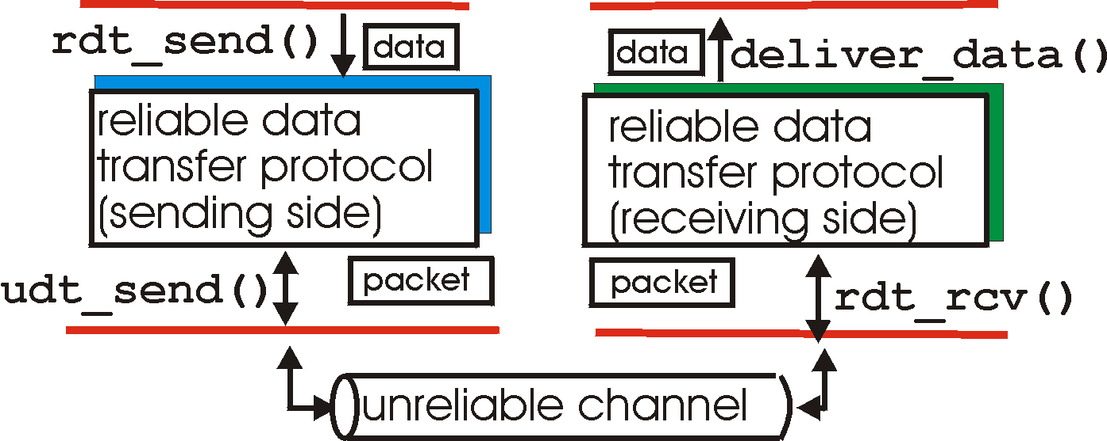
Reliable data transfer
rdt_send(): Application layer sends the message to transport layer
deliver_data(): message is arrived in application layer
sender
receiver
udt_send(): transport layer sends the segment to channel
rdt_rcv(): segment is arrived in transport layer

Slide 17
rdt1.0: reliable transfer over a reliable channel
Channel properties:
No corrupt
No lost
No out of order
Wait for call from above
rdt_send(data)
Wait for call from below
rdt_rcv(packet)
extract (packet,data)
deliver_data(data)
packet = make_pkt(data)
udt_send(packet)
sender
receiver

Slide 18
rdt2.0: channel with bit errors
Channel properties:
May corrupt
No lost
No out of order
We know how to detect error using checksum
If no error, receiver sends acknowledgements (ACKs). Then, sender sends the next packet.
If error, receiver sends negative acknowledgements (NAKs). Then, sender retransmits the packet.
Three major things: Error detection, Receiver feedback (ACK or NAK), Retransmission
It is also called Automatic Repeat reQuest (ARQ) protocol

Slide 19
rdt2.0
rdt_send(data)
sndpkt = make_pkt(data, checksum)
udt_send(sndpkt)
receiver
rdt_rcv(rcvpkt) &&
isNAK(rcvpkt)
Wait for call from above
Wait for ACK or NAK
rdt_rcv(rcvpkt) &&
corrupt(rcvpkt)
udt_send(sndpkt)
udt_send(NAK)
rdt_rcv(rcvpkt) && isACK(rcvpkt)
Λ
Wait for call from below
sender
stop and wait
rdt_rcv(rcvpkt) &&
notcorrupt(rcvpkt)
sender sends one packet,
then waits for receiver
response
extract(rcvpkt,data)
deliver_data(data)
udt_send(ACK)

Slide 20
Problem of rdt2.0
What happens if ACK/NAK corrupted?
Checksum is added with ACK/NAK
If ACK/NAK is corrupted, the sender retransmit the packet
handling duplicates
sender adds seq number (0 or 1) to each packet
receiver discards packets with same seq number
This gives us rdt2.1

Slide 21
rdt2.1
rdt_send(data)
sndpkt = make_pkt(0, data, checksum)
udt_send(sndpkt)
rdt_rcv(rcvpkt) &&
( corrupt(rcvpkt) ||
isNAK(rcvpkt) )
Wait for call 0 from above
Wait for ACK or NAK 0
udt_send(sndpkt)
rdt_rcv(rcvpkt)
&& notcorrupt(rcvpkt)
&& isACK(rcvpkt)
rdt_rcv(rcvpkt)
&& notcorrupt(rcvpkt)
&& isACK(rcvpkt)
Λ
Λ
Wait for ACK or NAK 1
Wait for
call 1 from above
rdt_rcv(rcvpkt) &&
( corrupt(rcvpkt) ||
isNAK(rcvpkt) )
rdt_send(data)
udt_send(sndpkt)
sndpkt = make_pkt(1, data, checksum)
udt_send(sndpkt)

Slide 22
rdt2.1
rdt_rcv(rcvpkt) && notcorrupt(rcvpkt)
&& has_seq0(rcvpkt)
extract(rcvpkt,data)
deliver_data(data)
sndpkt = make_pkt(ACK, chksum)
udt_send(sndpkt)
rdt_rcv(rcvpkt) && (corrupt(rcvpkt)
rdt_rcv(rcvpkt) && (corrupt(rcvpkt)
sndpkt = make_pkt(NAK, chksum)
udt_send(sndpkt)
sndpkt = make_pkt(NAK, chksum)
udt_send(sndpkt)
Wait for
0 from below
Wait for
1 from below
rdt_rcv(rcvpkt) &&
not corrupt(rcvpkt) &&
has_seq1(rcvpkt)
rdt_rcv(rcvpkt) &&
not corrupt(rcvpkt) &&
has_seq0(rcvpkt)
sndpkt = make_pkt(ACK, chksum)
udt_send(sndpkt)
sndpkt = make_pkt(ACK, chksum)
udt_send(sndpkt)
rdt_rcv(rcvpkt) && notcorrupt(rcvpkt)
&& has_seq1(rcvpkt)
extract(rcvpkt,data)
deliver_data(data)
sndpkt = make_pkt(ACK, chksum)
udt_send(sndpkt)

Slide 23
rdt2.1
sender:
seq # added to pkt. Does (0,1) suffice?
must check if received ACK/NAK corrupted
receiver:
must check if received packet is duplicate
state indicates whether 0 or 1 is expected pkt seq #

Slide 24
rdt2.2: a NAK-free protocol
rdt2.1 using ACKs only
How: instead of NAK, receiver sends ACK for last pkt received OK
receiver must explicitly include seq # of pkt being ACKed
duplicate ACK at sender results in same action as NAK: retransmit current pkt

Slide 25
rdt2.2: sender, receiver fragments
rdt_send(data)
sndpkt = make_pkt(0, data, checksum)
udt_send(sndpkt)
rdt_rcv(rcvpkt) &&
( corrupt(rcvpkt) ||
isACK(rcvpkt,1) )
Wait for call 0 from above
Wait for ACK
0
udt_send(sndpkt)
sender
rdt_rcv(rcvpkt)
&& notcorrupt(rcvpkt)
&& isACK(rcvpkt,0)
rdt_rcv(rcvpkt) &&
(corrupt(rcvpkt) ||
has_seq1(rcvpkt))
Λ
Wait for
0 from below
receiver
udt_send(sndpkt)
rdt_rcv(rcvpkt) && notcorrupt(rcvpkt)
&& has_seq1(rcvpkt)
extract(rcvpkt,data)
deliver_data(data)
sndpkt = make_pkt(ACK1, chksum)
udt_send(sndpkt)

Slide 26
rdt3.0: channels with errors and loss
Channel properties:
May corrupt (packet or ACK)
May be lost (packet or ACK)
No out of order
approach:
sender waits reasonable amount of time for ACK
retransmits if no ACK received in this time
if pkt or ACK just delayed (not lost), retransmission will be duplicate, but seq. # already handles this
requires countdown timer

Slide 27
rdt3.0 sender
rdt_send(data)
rdt_rcv(rcvpkt) &&
( corrupt(rcvpkt) ||
isACK(rcvpkt,1) )
sndpkt = make_pkt(0, data, checksum)
udt_send(sndpkt)
start_timer
rdt_rcv(rcvpkt)
Λ
Λ
Wait for
call 0from above
Wait for ACK0
timeout
udt_send(sndpkt)
start_timer
rdt_rcv(rcvpkt)
&& notcorrupt(rcvpkt)
&& isACK(rcvpkt,1)
rdt_rcv(rcvpkt)
&& notcorrupt(rcvpkt)
&& isACK(rcvpkt,0)
stop_timer
stop_timer
Wait for ACK1
Wait for
call 1 from above
timeout
udt_send(sndpkt)
start_timer
rdt_rcv(rcvpkt)
rdt_send(data)
Λ
rdt_rcv(rcvpkt) &&
( corrupt(rcvpkt) ||
isACK(rcvpkt,0) )
sndpkt = make_pkt(1, data, checksum)
udt_send(sndpkt)
start_timer
Λ

Slide 28

rdt3.0 in action
sender
receiver
sender
receiver
send pkt0
pkt0
send pkt0
pkt0
rcv pkt0
rcv pkt0
ack0
send ack0
ack0
send ack0
rcv ack0
rcv ack0
send pkt1
pkt1
send pkt1
pkt1
rcv pkt1
X
ack1
send ack1
loss
rcv ack1
send pkt0
pkt0
rcv pkt0
timeout
resend pkt1
ack0
send ack0
pkt1
rcv pkt1
ack1
send ack1
rcv ack1
send pkt0
pkt0
(a) no loss
rcv pkt0
ack0
send ack0
(b) packet loss

Slide 29
rdt3.0 in action
sender
receiver
sender
receiver
send pkt0
pkt0
send pkt0
pkt0
rcv pkt0
rcv pkt0
ack0
send ack0
send ack0
rcv ack0
ack0
send pkt1
pkt1
rcv ack0
rcv pkt1
send pkt1
pkt1
send ack1
rcv pkt1
ack1
send ack1
ack1
X
loss
timeout
resend pkt1
pkt1
rcv pkt1
timeout
resend pkt1
rcv ack1
pkt1
rcv pkt1
pkt0
(detect duplicate)
send pkt0
send ack1
ack1
(detect duplicate)
ack1
rcv pkt0
rcv ack1
send ack1
rcv ack1
ack0
send ack0
pkt0
send pkt0
pkt0
send pkt0
rcv pkt0
rcv pkt0
ack0
(detect duplicate)
ack0
send ack0
send ack0
(c) ACK loss
(d) premature timeout/ delayed ACK

Slide 30
Performance of rdt3.0
rdt3.0 is correct, but performance is poor
Example: 1 Gbps link, 8000 bits packet, RTT=30 msec
L
8000 bits
D_{trans} =
=
=
8 microsecs
R
10⁹ bits/sec
U _{sender} (utilization): fraction of time that the sender is busy sending

Slide 31
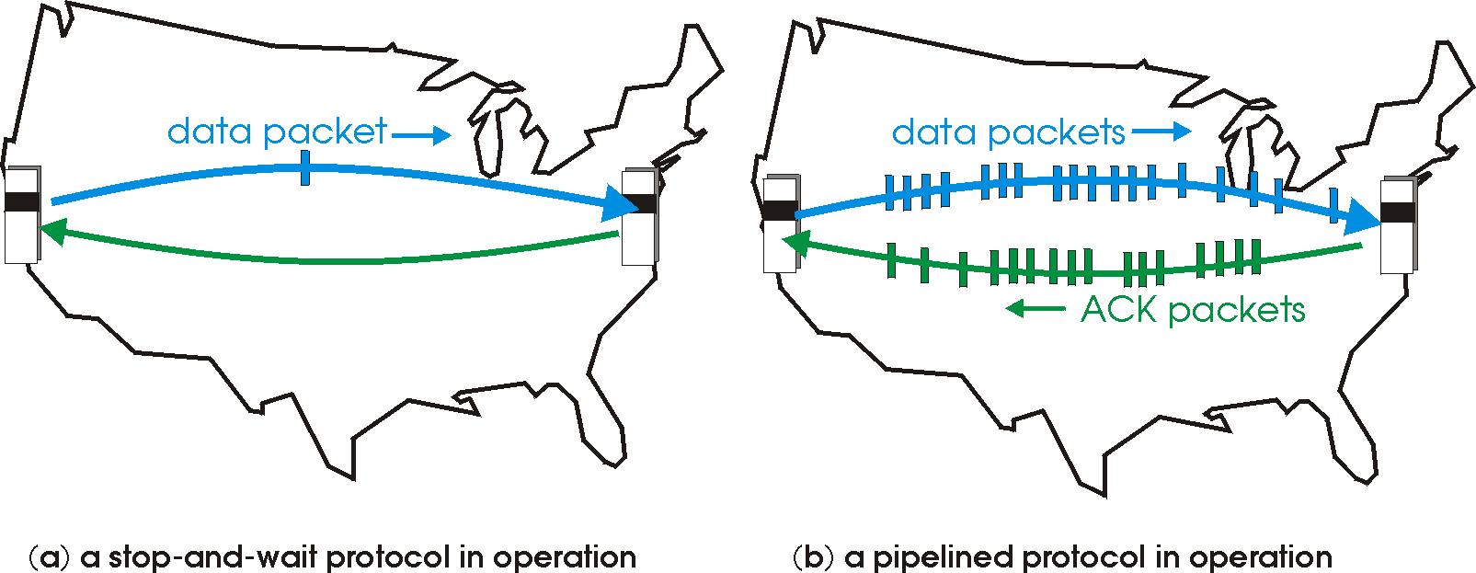

Pipelined technique
pipelining: sender is allowed to send multiple packets without waiting for acknowledgements
range of sequence numbers must be increased
buffering at sender and/or receiver
two pipelined protocols: go-Back-N (GBN), selective repeat (SR)

Slide 32
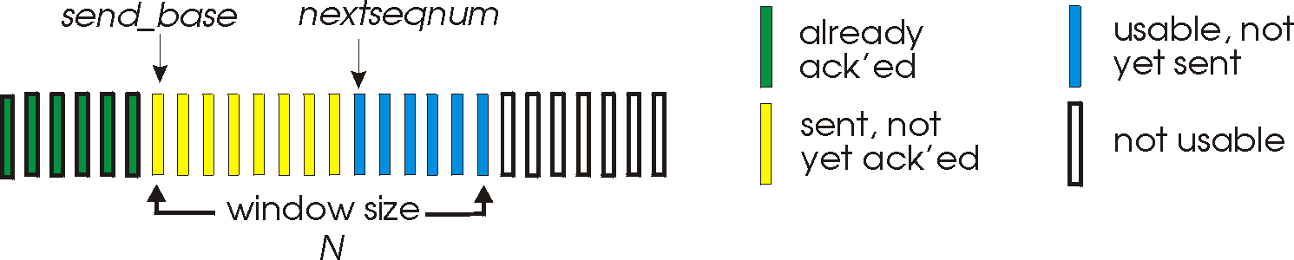
Go-Back-N: sender
32-bits seq number
Window size = N (maximum unacknowledged packets)
ACK(n): ACKs all pkts up to, including seq # n
How many timers? timer for the oldest send pkt
timeout(n): retransmit packet n and all higher seq # pkts in window
Also called Sliding window protocol

Slide 33
GBN in action
sender window (N=4)
sender
receiver
0 1 2 3 4 5 6 7 8
send pkt0
send pkt1
send pkt2
send pkt3
(wait)
0 1 2 3 4 5 6 7 8
receive pkt0, send ack0
receive pkt1, send ack1
receive pkt3, discard,
(re)send ack1
0 1 2 3 4 5 6 7 8
X
0 1 2 3 4 5 6 7 8
loss
0 1 2 3 4 5 6 7 8
rcv ack0, send pkt4
rcv ack1, send pkt5
0 1 2 3 4 5 6 7 8
receive pkt4, discard,
(re)send ack1
ignore duplicate ACK
receive pkt5, discard,
(re)send ack1
pkt 2 timeout
0 1 2 3 4 5 6 7 8
send pkt2
send pkt3
send pkt4
send pkt5
0 1 2 3 4 5 6 7 8
0 1 2 3 4 5 6 7 8
rcv pkt2, deliver, send ack2
rcv pkt3, deliver, send ack3
rcv pkt4, deliver, send ack4
rcv pkt5, deliver, send ack5
0 1 2 3 4 5 6 7 8

Slide 34
Selective repeat (SR)
Timer for each packet
sender resends a pkt if the ACK is not received in reasonable time
Receiver acknowledges all correctly received pkts
sender window
N consecutive seq #’s
limits seq #s of sent, unACKed pkts

Slide 35
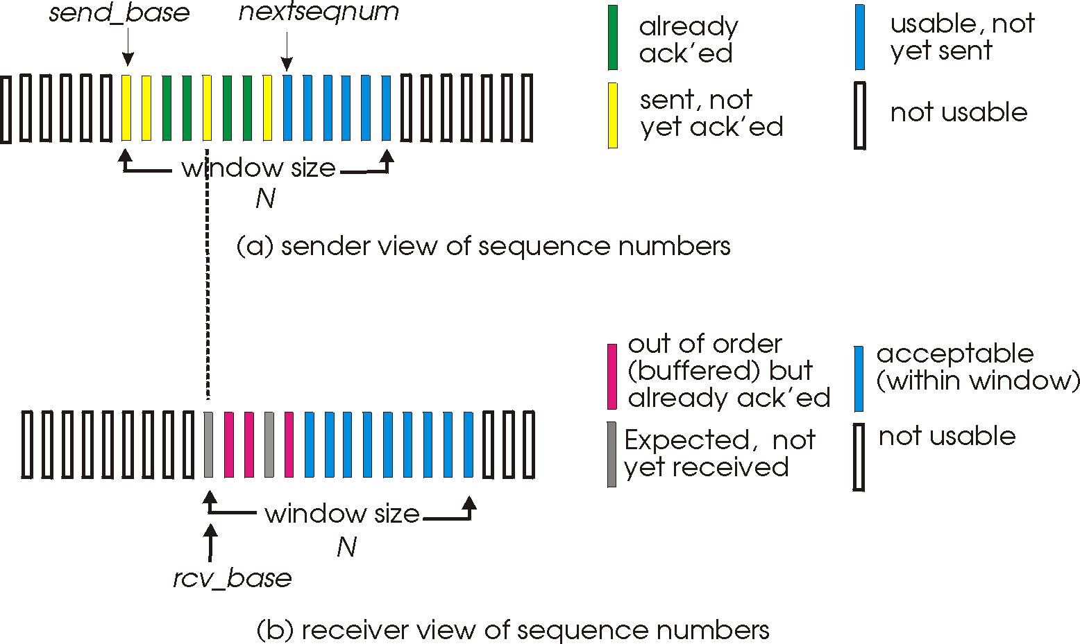
SR: sender and receiver windows

Slide 36
SR
sender
receiver
data from app layer:
if next available seq # in window, send pkt
timeout(n):
resend pkt n, restart timer
ACK(n):
mark pkt n as received
if n smallest unACKed pkt, advance window base to next unACKed seq #
pkt n in [rcvbase, rcvbase+N-1]
send ACK(n)
out-of-order: buffer
in-order: deliver (also deliver buffered, in-order pkts), advance window to next not-yet-received pkt
pkt n in [rcvbase-N,rcvbase-1]
ACK(n)
otherwise:
ignore

Slide 37
SR in action
sender window (N=4)
sender
receiver
0 1 2 3 4 5 6 7 8
send pkt0
send pkt1
send pkt2
send pkt3
(wait)
0 1 2 3 4 5 6 7 8
receive pkt0, send ack0
receive pkt1, send ack1
receive pkt3, buffer,
send ack3
0 1 2 3 4 5 6 7 8
X
0 1 2 3 4 5 6 7 8
loss
0 1 2 3 4 5 6 7 8
rcv ack0, send pkt4
rcv ack1, send pkt5
0 1 2 3 4 5 6 7 8
receive pkt4, buffer,
send ack4
record ack3 arrived
receive pkt5, buffer,
send ack5
pkt 2 timeout
0 1 2 3 4 5 6 7 8
send pkt2
0 1 2 3 4 5 6 7 8
record ack4 arrived
0 1 2 3 4 5 6 7 8
rcv pkt2; deliver pkt2,
pkt3, pkt4, pkt5; send ack2
record ack5 arrived
0 1 2 3 4 5 6 7 8
Q: what happens when ack2 arrives?

Slide 38
TCP Connection
Three way handshake
Client sends a segment
Receiver sends a segment
Client sends another segment and also data
point-to-point:
one sender and one receiver
No broadcasting possible
full duplex service: In both way.
Maximum Segment Size (MSS):
Maximum data that can be contained in a segment
Maximum Transmission Unit (MTU) - TCP header info = 1500 bytes – 40 bytes = 1460 bytes

Slide 39
TCP segment structure
32 bits
URG: urgent data
(generally not used)
counting
by bytes
of data
(not segments!)
source port #
dest port #
sequence number
ACK: ACK #
valid
acknowledgement number
head
len
not
used
U
receive window
A
PSH: push data now
(generally not used)
P
R
S
F
# bytes
rcvr willing
to accept
(used for
Flow control)
checksum
Urg data pointer
RST, SYN, FIN:
connection estab
(setup, teardown
commands)
options (variable length)
application
data
(variable length)
Internet
checksum
(as in UDP)

Slide 40
Estimated RTT and timeout
Estimate RTT:
SampleRTT: measure a typical RTT for a segment
However, SampleRTT will vary. So, take an average of several measurements
Estimate timeout:
timeout = EstimatedRTT + Safety Margin

Slide 41
TCP flow control
The receiver application may be busy and so the data is buffered. If the buffer overflows, the data will be lost.
Flow control: the receiver sends rwnd (with the segment) to the sender indicating how many bytes the receive can accept.
rwnd is dynamic.
It guarantees that the RcvBuffer will not overflow
to application process
RcvBuffer
buffered data
rwnd
free buffer space
TCP segment payloads
receiver-side buffering

Slide 42
Congestion
Congestion occurs due to too many sources a router needs to handle
Long delay occurs for queuing in router buffer
Packet lost occurs due to overflow of router buffer
End-to-end congestion control: Network layer does not participate in this approach. TCP uses this approach.
Network-assisted congestion control: Routers provide feedback to sender and receiver regarding the current state of the network

Slide 43
TCP congestion control: additive increase multiplicative decrease
cwnd = congestion window (maximum bytes that the sender can send)
additive increase: increase cwnd by 1 MSS every RTT until loss detected
multiplicative decrease: cut cwnd in half after loss
additively increase window size …
…. until loss occurs (then cut window in half)
AIMD saw tooth
behavior: probing
for bandwidth
cwnd: TCP sender
congestion window size
time

Slide 44
TCP Congestion Control
sender sequence number space
cwnd
last byte
ACKed
last byte sent
sent, not-yet ACKed
sender limits transmission:
cwnd is dynamic
<
LastByteSent –LastByteAcked cwnd

